Slide 1
Introduction to AngularJS
Rami Sayar - @ramisayar
Technical Evangelist
Microsoft Canada

Slide 2
Agenda
What are Single Page Applications?
What is AngularJS?
Angular Directives, Filters & Data Binding
Angular Models
Angular Views
Angular Controllers

Slide 3
What are Single Page Applications (SPA)?
As web apps become more dynamic and complex, developers want to fit the entire web app in a single page and control the application from JavaScript to provide a more fluid user experience.
Single Page Applications are web apps that load all the HTML, JS, CSS in a single request and then retrieve bits of data.
Reference: Wikipedia

Slide 4
Comparison: Standard Page Requests
Client Browser
Request: http://site.com/products/
Web Server
HTML
CSS
Images
JavaScript
Response: Full page
Request: http://site.com/products/6
Response: Full page
HTML
CSS
Images
JavaScript

Slide 5
Comparison: Single Page Application
Client Browser
Request: http://site.com/products/
Web Server
HTML
CSS
Images
Javascript
Response: Full page
Request: http://site.com/products/6
Response: Tiny bit of data
{product}

Slide 6
What is AngularJS?
It’s not a library… it’s kind of a framework… but really it’s an HTML Extender/Compiler.

Slide 7
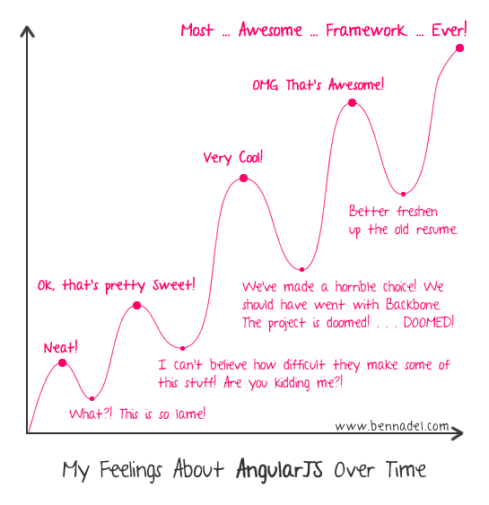

Slide 8
Why Angular?
Building SPAs is difficult. Need to manage state, views, dynamic HTML, URLs, routing, templating, etc.
Angular is a framework that handles all of that for you and more including module loading, two-way data binding, handling REST APIs, etc.

Slide 9

Angular Design Pattern
Model-view-controller (MVC) is a common design pattern for implementing web applications.
A controller manipulates a model and activates the view.
A model stores data that is retrieved by a controller.
A view displays data from a model.
Reference: Wikipedia

Slide 10
MVC in Angular
Reference: AngularJS in 60 Minutes Ish by Dan Wahlin

Slide 11
Views in MVC & Angular Directives
Angular introduces Directives that do all your DOM manipulations.
Directives teach HTML new tricks by adding new attributes, elements, etc.
Turn HTML from a markup language to a “declarative” language.

Slide 12
Angular Directives
Angular Directives are custom tags and attributes added to your HTML or JavaScript.
Normalized Naming:
camelCase in JavaScript
hyphen-case in HTML

Slide 13
Angular Directives
ng-app: auto-bootstraps an AngularJS application. Designates the root element of the app. Maps to angular.module().
ng-model: binds a view into the model. Normally binds to input, select, textarea, etc. elements, provides validation and handles dirty state.
ng-controller: attaches a controller to the view.

Slide 14
Angular Directives
ng-if: adds/removes elements from DOM
<p ng-if=“price > 0”>BUY</p>
ng-show/ng-hide: CSS show/hide elements
<p ng-show=“price < 0”>WARN</p>
<p ng-show=“price > 0”>YIKES</p>

Slide 15
Angular Directives
ng-if: adds/removes elements from DOM
<p ng-if=“price > 0”>BUY</p>
ng-show/ng-hide: CSS show/hide elements
<p ng-show=“price < 0”>WARN</p>
<p ng-show=“price > 0”>YIKES</p>

Slide 16
Angular Directives
ng-class: Dynamically change CSS class
<p ng-class=“{red:price<0, green:price>5}”>{{price}}</p>
<p ng-class=“price < 0 ? ‘red’ : ‘green’”> {{price}}</p>
ng-style: Similar to ng-class but adds styles

Slide 17
Angular Directives
ng-repeat: iterates over every element in an array or key-value pairs.
<p ng-repeat=“cat in cats”>{{cat.name}}</p>
<p ng-class=“(key, value) in cat”>{{key}}: {{value}}</p>

Slide 18
Angular Directives
$filters: allow you to format and manipulate data piped into $filters.
Currency
Date
Time
Filter
Sort
OrderBy
<p> {{date | date:dd/MM/yy}} </p>

Slide 19
Models in Angular
Models store data. Communication between the Model and the view is handled by the Controller.
Model binds to the View (a.k.a. the HTML) through the $scope with the Controller function.
Binding can be one way, once, or two way.
Updates in View reflected in Controller and vice-versa.

Slide 20
Angular Models
ng-model: allows you to bind a model in the scope to a view element.
<p>My name is {{name}}</p>
<input ng-model=“name” />

Slide 21
Controllers in MVC
Controllers coordinate between the view and model.
In Angular, the controller is a function that can be created.
The controller declares a $scope for the view, normally the scope is the model.
Enriches the $scope with functions and data.

Slide 22
Controllers in Angular
Controllers are hierarchical: can have parent-child relationships with inheritance (inheritance can apply to $scopes).
Views can read from parent $scopes.
Root in the inheritance tree is the $rootScope, created for every Angular app.

Slide 23
On the $scope
The $scope is very similar to the ViewModel in MVVM patterns.
Anything you need access to in the View should go on your $scope.
Angular watches everything in the scope for changes. It does dirty-state checking on the View automatically.
Don’t add anything to the $scope unless the View needs it.

Slide 24
On $scope watching
Angular will watch $scope variables
Value changes in JS re-render the relevant DOM element.
Your directives fire the watch action to reflect model changes in the JS.
$watch: you can set a callback function for anything that changes in the $scope.
$scope.$watch(‘myvalue’, callback);

Slide 25
More $watch
$watch(var, function) // watch variable
$watch(object, f, true) // deep watch
$watchCollection(array, f) // watch contents

Slide 26
How $watch works
$digest: calls watch on the current $scope.
$apply: calls $digest on $rootScope and inherited scopes.
Current suggested limit for number of concurrent watches is approximately 2000 or else slower machines/browsers will fail to function correctly.

Slide 27
Putting it all together – Angular Modules
Creating a Module allows you to create Controllers, Views, Directives, etc. and group the different components together.
Modules take a config object that describes the routes to the different Controllers & Views. (More later)
angular.module(‘appName’, [/*deps*/]);
angular.module(‘appName’).controller(‘MainCtrl’,
[‘$scope’, function($scope){
$scope.title= ‘hello world’;
}]
);

Slide 28
Dependency Injection
All dependencies in Angular are injected based on name: e.g. Directives, Views, Models, Controllers.
Note: Certain JS minifiers will change variable names, thus breaking Angular dependency injection.
Minifiers don’t touch strings, so we use strings instead:
[‘$scope’, ‘$filter’, function($scope, $filter){}]

Slide 29
Thank You! Questions?
tw: @ramisayar | gh: @sayar
slideshare.net/ramisayar

Slide 30

Time for the evaluation
http://aka.ms/FullstackVancouverEval

